Slide 1


Data Visualization Hackathon and Assignment
Instructor: Shri Harini Ramesh
April 28 – May 2, 2025

Slide 2
Forming Your Groups

Slide 3
Pick a paper: Each paper has five parts of a unique story.
Read your part: When you get your paper, read the sentence carefully.
Find the other parts: You will need to find others who have the matching parts of your story.
Work together: Once you’ve found your group, work together to piece the full story.
Present your story: After forming your group, you’ll share your completed story with the class.

Slide 4
https://datascience4health.netlify.app/hackathon

Slide 5
Hackathon Steps
Data Collection
Data Cleaning and Organization
Data Analysis (Optional)
Data Visualization
Final Presentation

Slide 6
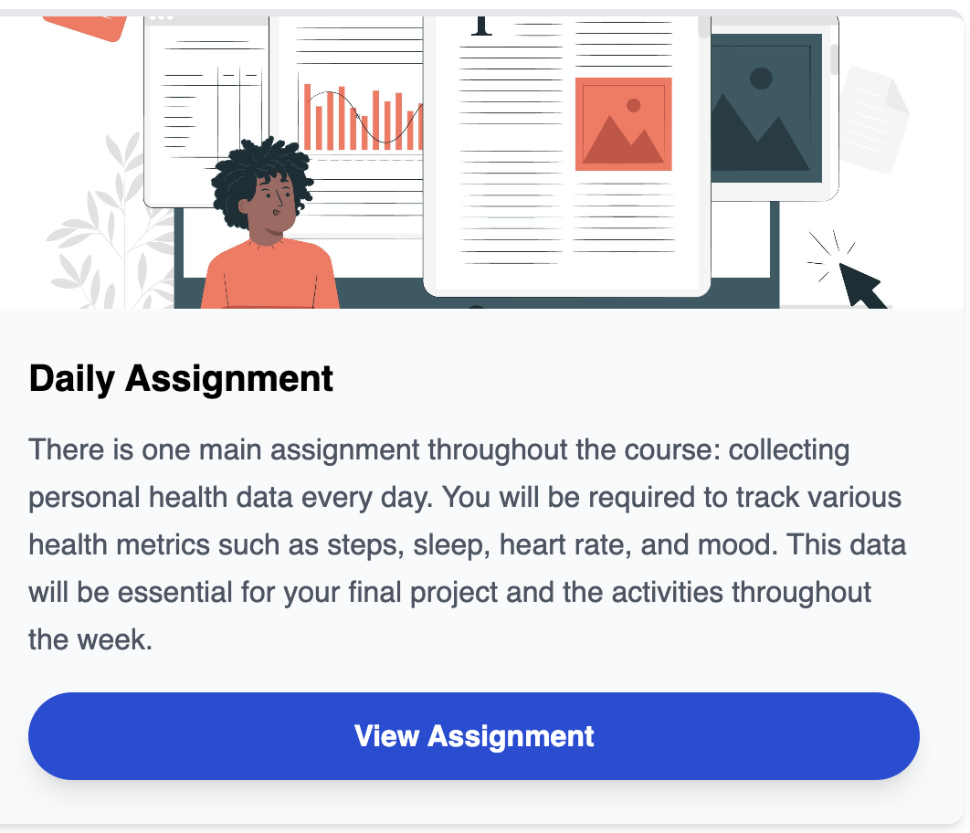
Hackathon Steps
Data Collection

Slide 7
Hackathon Steps
Data Cleaning and Organization
We will learn how to clean and organize data on April 29 (Day 2)

Slide 8
Hackathon Steps
Data Analysis (Optional)
We will learn how to analyze data using AI on April 30 (Day 3)

Slide 9
Hackathon Steps
Data Visualization
You can choose between a digital visualization or a physical one

Slide 10
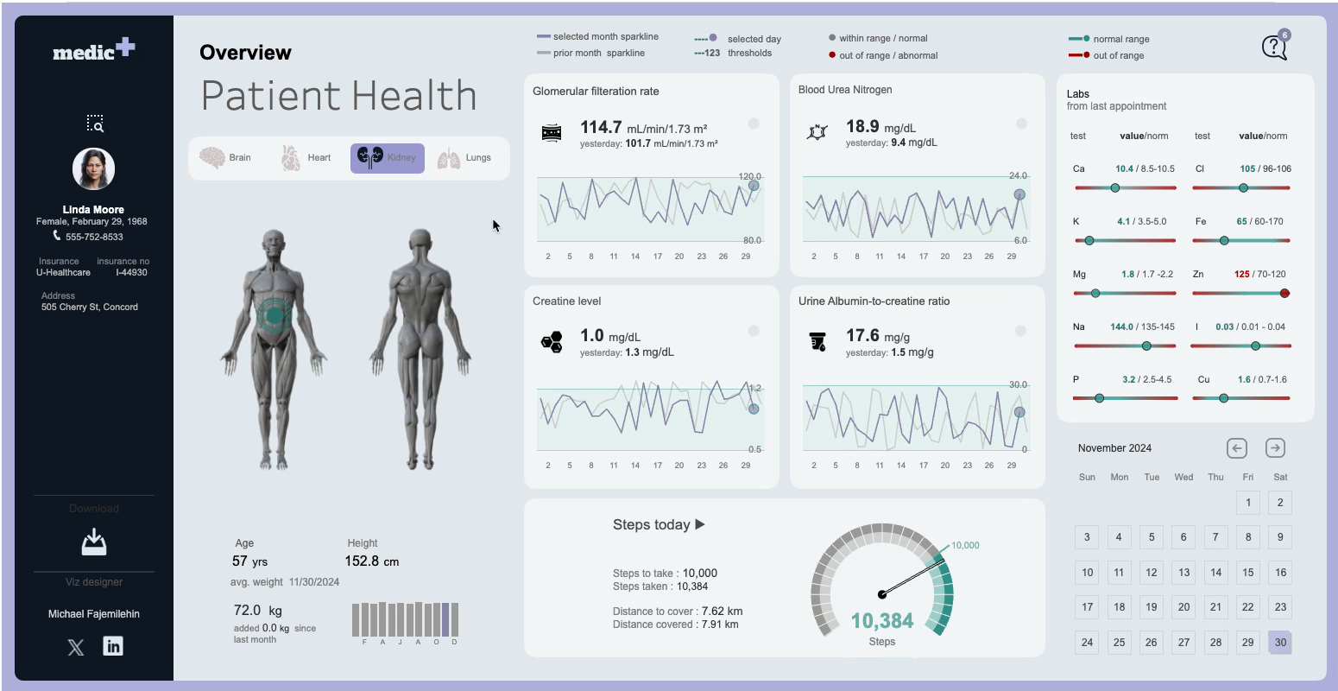

Slide 11
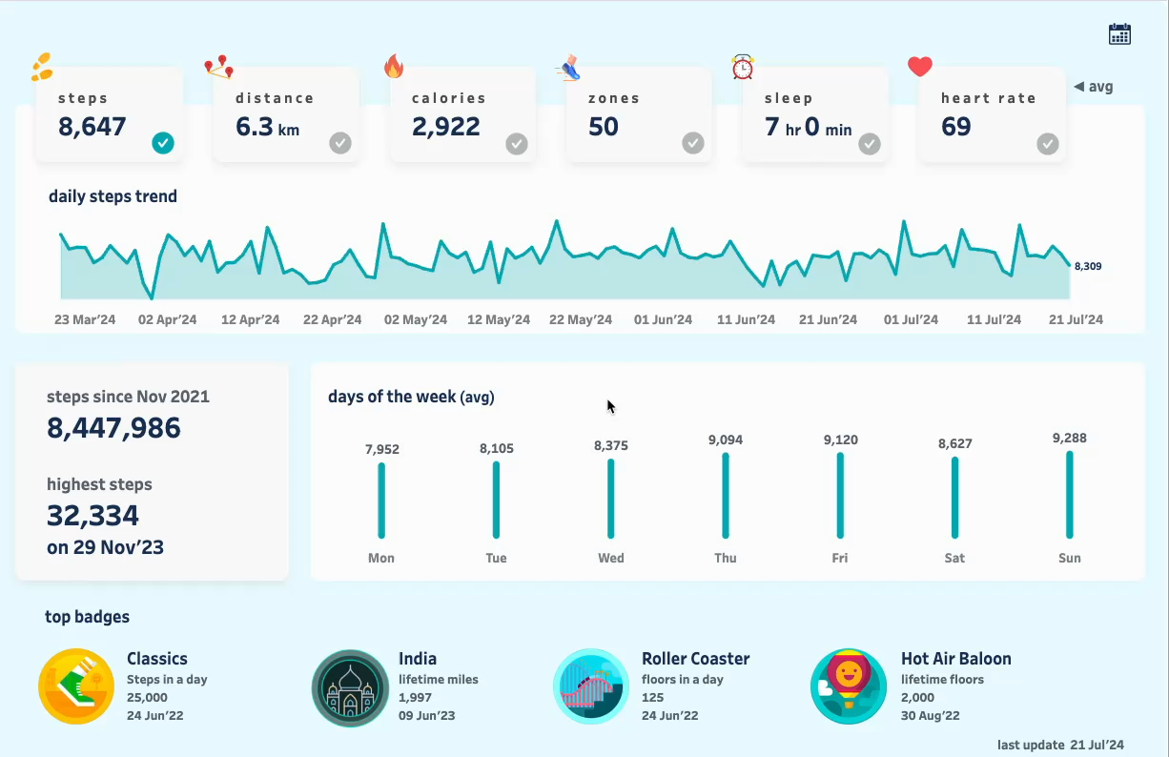

Slide 12
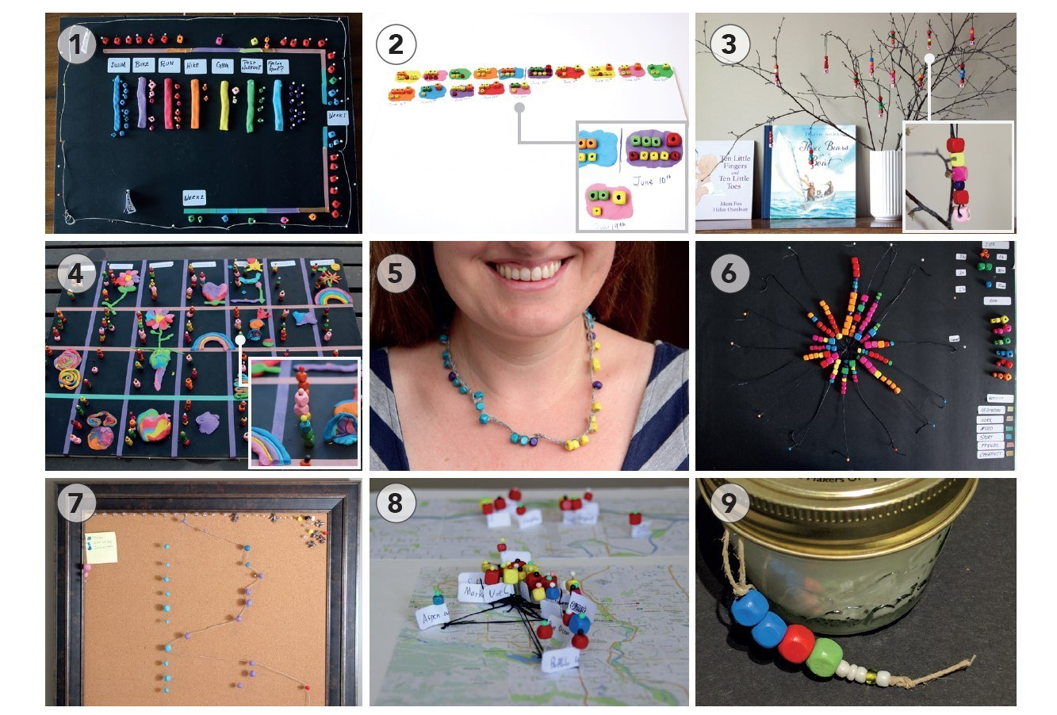

Slide 13
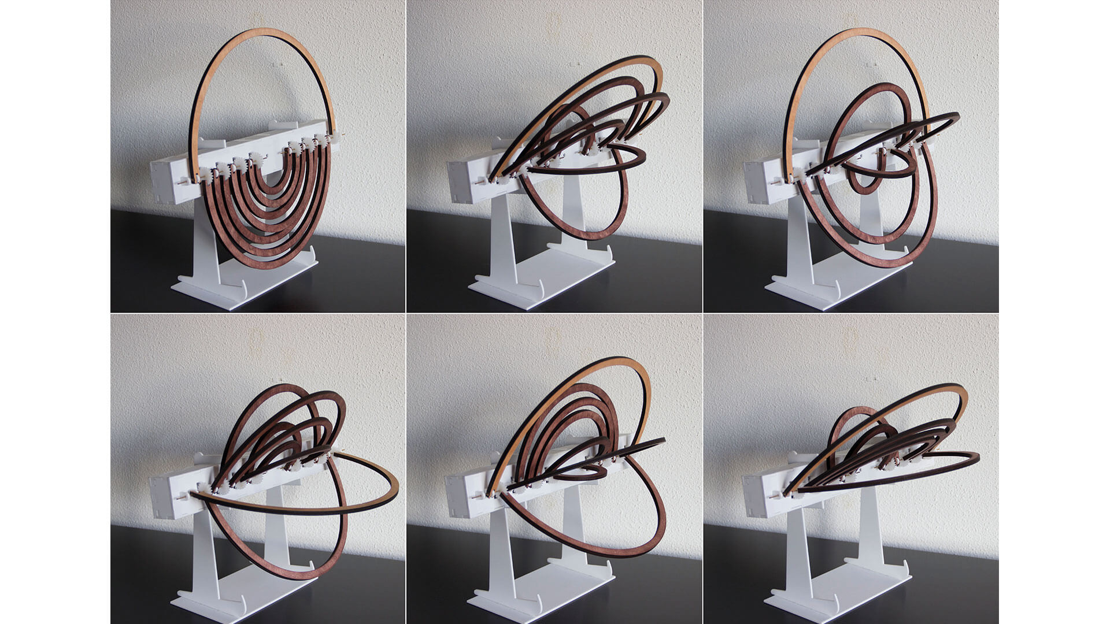

Slide 14
Hackathon Steps
Final Presentation
May 2, 2025
1-3 pm

Slide 16
https://datascience4health.netlify.app/assignment

Slide 17
Let’s Plan Your Data Collection

Slide 18
Group Name?
1. Pick a fun/clever name that reflects your vibe or theme

Slide 19
Health Question?
2. Come up with at least 5 health-related questions you want to explore
It can be one question per person, OR
A few shared questions the whole team collects data for

Slide 20
Examples
What habits make us feel the most productive?
Does more sleep really mean better mood?
How much do steps actually change our energy?

Slide 21
Why This Matters?
Your questions will guide what data you need to collect
You must collect at least 5 metrics per person per day
(More is better—good data = better dashboards!)

Slide 22
Plan your Data Collection
What data is each person collecting?
How will they track it?

Slide 23
Decide on Dashboard Approach
Will your final hackathon project be:
✅ One combined group dashboard, or
✅ Individual dashboards, all linked to the group theme?

Slide 24
Prepare a Short Group Pitch
Each group will share:
Group name
Your guiding health questions
What data you’re collecting (and how)
Your planned dashboard type

